Slide 1
Welcome Everyone

Slide 2



Mood - temporary state of mind or feeling

Slide 3
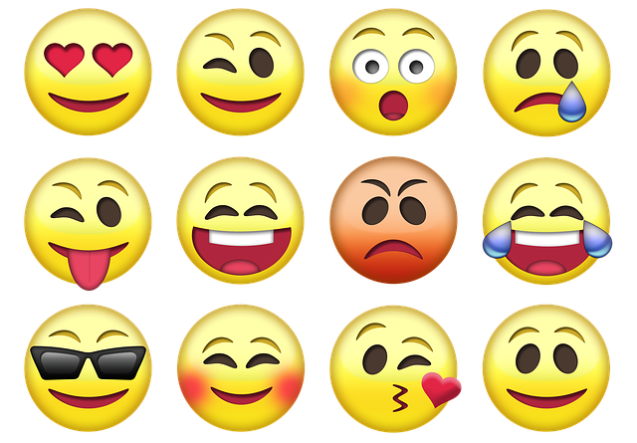
Emoticon That express easily HUMAN mood

Slide 4

HOW CAN WE SWING ONE’s MOOD

Slide 5

Exists !!!! 😉

Slide 6

MOOD SWING
Android App

Slide 7
Developed by:
Md. Parves Alam [15162103117]
Yakub Ali [15162103104]
Raisul Islam [15162103130]

Slide 8
Introduction:
we would like to build an android app that
can swing and thrill up our regular mood. Then we decided to develop an app named “Mood Swing”. This app is made for people of all ages. There is no
restriction using this app among child to old-age person.

Slide 9
Modules :
We can use this app for swing people's mood and change it in a while.
This app is able to recharge one’s mind with musical vibe.

Slide 10
User Interface

Slide 11


Slide 12
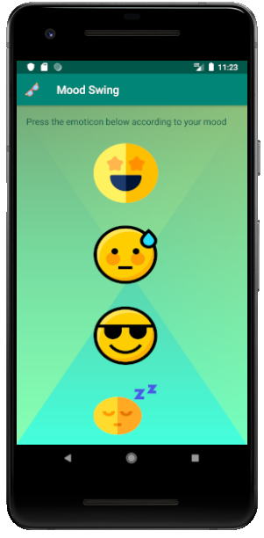
Home Screen

Slide 13
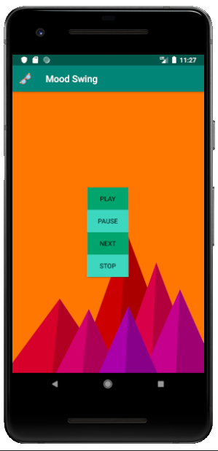

Slide 14
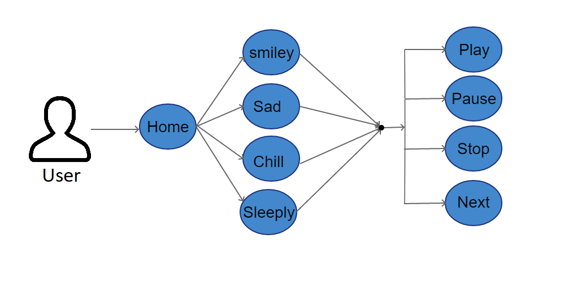
Use case:

Slide 15
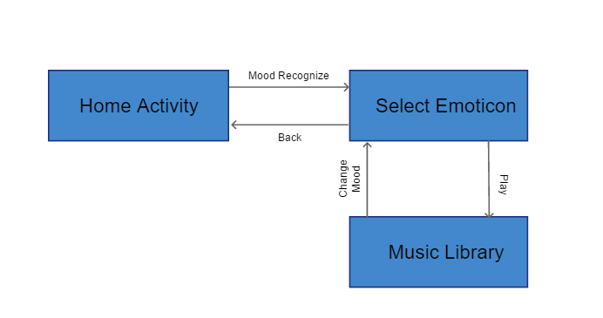
Data flow:

Slide 16
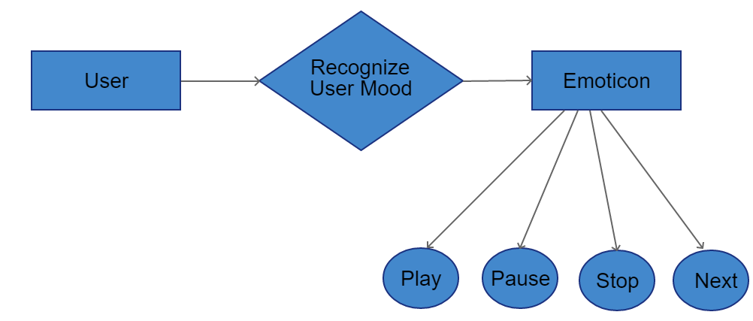
E-R diagram:

Slide 17
Budget:
High level computer(1)
Processor:- core i5 or core i7.
Windows 10 pro.
Normal computer(2)
Processor:- core i3.
Windows 8+ version requirement.
Software.
Pen-drive.
USB Cable
Internet.
Paper.
File.

Slide 18
The test items for Mood Swing Android app are as follows:
Play Audio file
Pause Audio file
Turning Next Audio file
Stop Audio file

Slide 19
Future works:
Firstly,
We would like to update this app with online huge amount of audio resources.
Secondly,
We would like to detect face expression with this app and thus it suggest music from those online audio libraries.
Thirdly,
3D animated face-emoji will be added.
Forthly,
Quote suggestion according to face expression will be applied.

Slide 20

Any Question ?

Slide 21
Thank You Everyone

